Slide 1
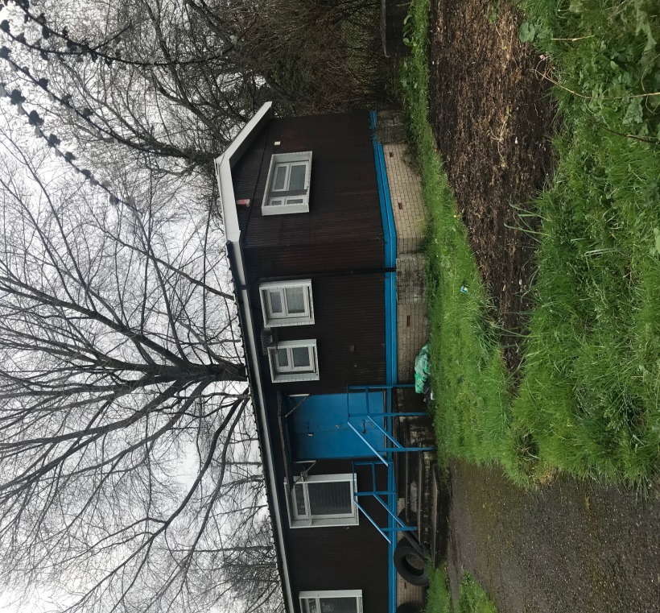
STRATEGIC ESTATES
DEPARTMENT
Former TA Premises, Ball Lane,
Llanrumney, Cardiff
All offers must be received no later than 8th June 2018
This document is available in Welsh / Mae’r ddogfen hon ar gael yn Gymraeg
www.cardiffcouncilproperty.com
Gweithio dros Gaerdydd, gweithio gyda’n gilydd
Working for Cardiff, Working together
1

Slide 2
STRATEGIC ESTATES
DEPARTMENT
Introduction
Cardiff Council would like to invite interested operators to submit offers for the letting of the TA Premises at Ball Lane in the Llanrumney area of Cardiff.
Location
The site location of the property is shown below in addition to an aerial image of the area.
Site area is approximately 0.12 acres.
Accommodation
Approx. Hall Area 84 sq. m. / 904 sq. ft.
Approx. Store area: 4.6 sq. m. / 49.5 sq. ft.
Location
Location
www.cardiffcouncilproperty.com
Gweithio dros Gaerdydd, gweithio gyda’n gilydd
Working for Cardiff, Working together
1

Slide 3
STRATEGIC ESTATES
DEPARTMENT
Proposed Lease Terms
Term | A lease for a term of 3-5 years (from a date to be agreed).
Use | The premises may be used for Assembly and Leisure (Use Class D2). All interested parties should make their own enquiries to the local authority.
Rent | Offers invited in the region of £5000 per annum.
Repairs | The lessee to be responsible for all internal repairs & external repairs, decoration and fitting out including repairs to all doors and windows.
Insurance | The lessee to be responsible for adequately insuring the property through an insurance company approved by the City and County Treasurer
Outgoings | The lessee to be responsible for the payment of rates, water charges, electricity charges and other assessments levied on the premises
Other | The lease to be subject to such other terms and conditions as the Council’s Chief Legal Services Officer considers appropriate.
Costs | The lessee will make a contribution the Council’s reasonable surveyors and legal costs amounting to £750.
Closing date | All offers must be received no later than Friday 8th June 2018
Contact:
Liam Slater (Surveyor)
Tel : 02920 873559
Email : Liam.Slater@cardiff.gov.uk
Gweithio dros Gaerdydd, gweithio gyda’n gilydd
Working for Cardiff, Working together
1

Slide 4
STRATEGIC ESTATES
DEPARTMENT
I / We................................................................have read the conditions of sale attached and hereby offer, subject to contract, the rental sum of:
£ .............................................................. (pounds) ........................................ (pence)
(£ : p) per month excluding VAT
I / We understand that we are submitting this offer at our own expense and that the Council is not bound to accept any offer.
I / We declare that we are not party to any scheme or agreement under which:
I / We inform any other person the amount of our offer; and/or
I / We have fixed the amount of any offer in accordance with a price fixing arrangement.
I / We accept that the Council is entitled to cancel the contract and to recover from us the amount of any loss resulting from such cancellation if it is discovered that there has been any corrupt or fraudulent act or omission by which in any way induced the Council to enter in to the contract.
I / We agree that if, before acceptance of this offer, any doubt exists as to the amount of this offer we will be afforded the opportunity of clarifying the amount of the offer or withdrawing the offer.
I / We agree that the insertion by us of any qualifications to this offer or any unauthorised alterations to any of the particulars will not affect the original text but will cause the offer to be liable to rejection.
I / We agree that the offer will remain open for acceptance by the Council and will not be withdrawn by us for a period of 28 days from the last date fixed for the receipt of offers or any notified extension thereof.
I / We certify that this is a bona fide offer.
I / We agree to paying the surveyor and legal fees of £750.00
This is not a binding offer and the Council reserves the right to not accept any offer received.
Gweithio dros Gaerdydd, gweithio gyda’n gilydd
Working for Cardiff, Working together
1

Slide 5
STRATEGIC ESTATES
DEPARTMENT
Address
Telephone
Name
Signature
Date
Witness name
Witness signature
Date
Business Plan information (attach if more space required)
Gweithio dros Gaerdydd, gweithio gyda’n gilydd
Working for Cardiff, Working together
7

Slide 6
STRATEGIC ESTATES
DEPARTMENT
Where the Offeror is an incorporated “ body or ” association, the company secretary or a duly authorised director “ or trustee ” should sign. In the case of a partnership a partner should sign. In the case of an individual the proprietor should sign.
This form of offer should not be detached and the whole document should be returned intact in the envelope provided to:
Liam Slater MRICS - Surveyor
Strategic Estates, Economic Development, Room CY6 ( Courtyard ), County Hall, Atlantic Wharf Cardiff, CF11 5UW Tel: 029 20873559
Email: Liam.Slater@cardiff.gov.uk
All offers must be received no later than Friday 8th June 2018
If you require this document in Welsh please email the valuation inbox valuation@cardiff.gov.uk
Also feel free to visit our Strategic Estates website www.cardiffcouncilproperty.com
Disclaimer:
1. The information above and contained within this document is given as a general outline only for the guidance of interested parties
and does not constitute part of an offer or contract.
2. All descriptions, dimensions, plans, reference to condition and necessary permissions for use and occupation and other details are
given without responsibility and any interested parties should not rely on them as statements or representations of fact, but must
satisfy themselves by inspection or otherwise as to the correctness of each of them.
3. No person in the employment of Cardiff Council has authority to make or give any representations or warranty whatsoever in
relation to this property/land.
4. The Council reserves the right not to accept any offer received.
Gweithio dros Gaerdydd, gweithio gyda’n gilydd
Working for Cardiff, Working together
8

